Slide 1

GENDER AND HUMAN RIGHTS

Slide 2

HUMAN RIGHTS
Human rights are moral principles that set out certain standards of human behavior, and are regularly protected as legal rights in national and international law.
Human rights are thus conceived as universal (applicable everywhere) and egalitarian (the same for everyone).

Slide 3


Gender and Human Rights include:
Right to life
Right to property
Right to reputation
Political rights
Economic rights
Civil rights
No discrimination

Slide 4


Article 1
All human beings are born free and equal in dignity and rights.
Article 23
Everyone has the right to work, to free choice of employment, to just and favorable conditions of work and to protection against unemployment.
The right to equal pay for equal work.

Slide 5

Gender based discrimination in some regions lead stone for the construction of rights like,
Women rights
Rights of homosexuals
Sexual rights

Slide 6
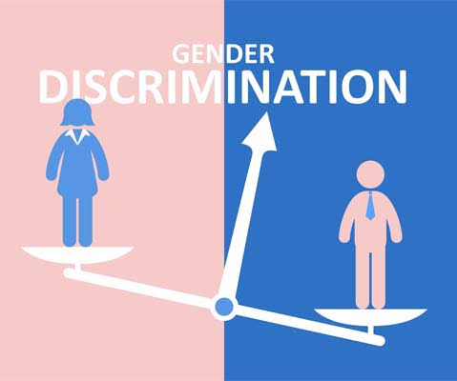
GENDER BASE DISCRIMINATION
Despite of all the conventions and the work done on gender issue Violence against women continues at breathtaking rates.
Gender- based discrimination persists in the workplace, and in housing, education, disaster relief, political life, inheritance, health care, access to food, and countless other areas.

Slide 7
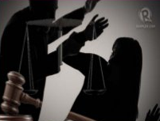
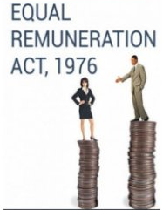
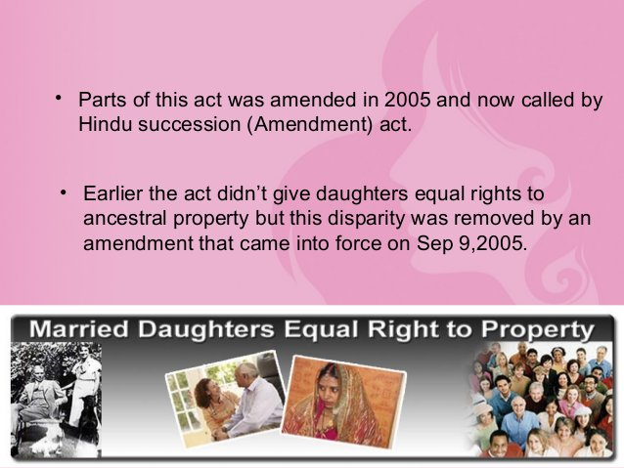
Gender Human Rights
Domestic Violence Act, 2005: Punishments for acts include a jail sentence of up to 1 year or rupees 20000 fine.
Hindu Succession Act,1956: This gives equal rights to ancestral property to all gender.
Equal Remuneration Act,1976: Duty of employer to pay equal remuneration to men and women workers for same work or similar nature of work.

Slide 8
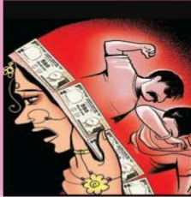
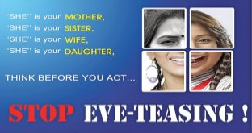
Dowry prohibition act 1961: If any person gives or takes dowry, he shall be punishable with imprisonment for not less than 3 years and with fine not be less than 15 thousand.
Eve Teasing Act, 2011: Eve teasing is a ridiculous form of enjoyment for men and a physical as well as mental torment for women.
Causes Of Eve Teasing:
Lack of family values
Stereotypical beliefs
Influence by friends
For fun and pleasure

Slide 9
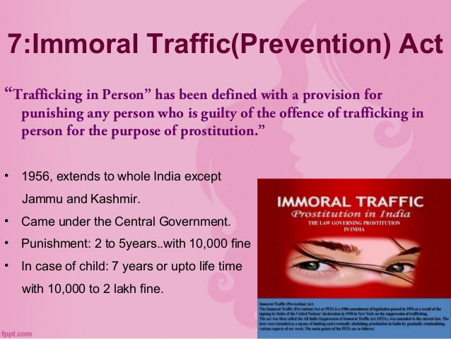
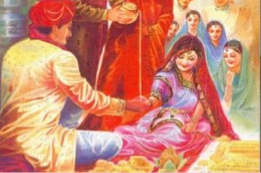
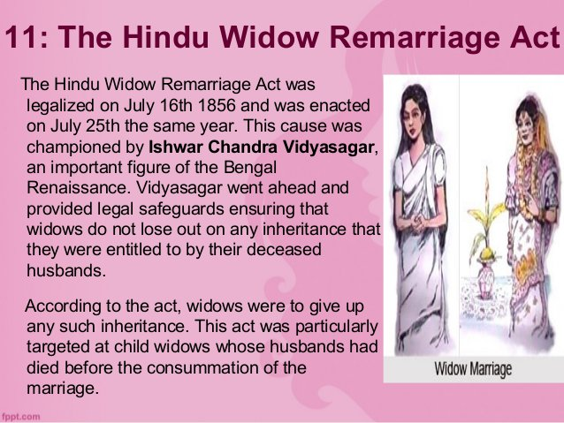
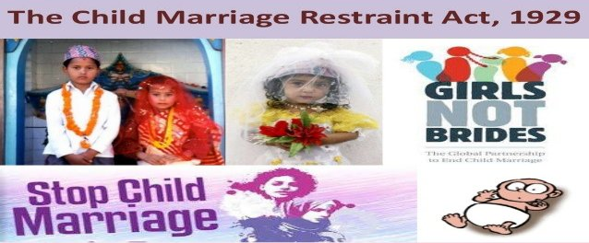
Maternity Benefit Act, 1961
Immoral Traffic(Prevention) Act
CHILD MARRIAGE RESTRAINT ACT,1929
Hindu Marriage act : The bridegroom should be of 21 years of age and the bride of 18 years
The Widow Remarriage Act

Slide 10

Schemes for Welfare of Women
Short Stay Home For Women and Girls(SSH): Aim is to provide temporary accommodation to the girls and women which are homeless.
Kishori Shakti Yogana : Aims to improve the nutritional, health and development status of adolescent girls.
Support to Training and Employment Program for Women (STEP) : Launched by government of India in 1986-87. Aim is to upgrade skills of women for self and wage employment
Swadhar : Provide shelter, food, clothing, and health as well as economic and social security for such women

Slide 11

Women Empowerment
Women Empowerment refers to increasing the spiritual, political, social, educational, gender, or economic strength of individuals and communities of women.
Need For Women Empowermnent Women Are Deprived Of:
Decision Making Power
Freedom of Movement
Access to Education
Access to Employment
Exposure to Media
Domestic Violence

Slide 12

Ways to Empower Women
Providing education
Self employment and Self help groups
Providing minimum needs like nutrition, health, sanitation, housing
Encouraging women to develop in their fields they are good at and make a career.

Slide 13


